Slide 1
ZIGBEE AND LOW-POWER WIRELESS NETWORKS: ARCHITECTURE, APPLICATIONS, AND CHALLENGES
Md. Sayeed Anwar Seam, Mir Sharjil Hasan, Saracini Kleivi
Department of Electronic Engineering, Hochschule Hamm-Lippstadt

Slide 2
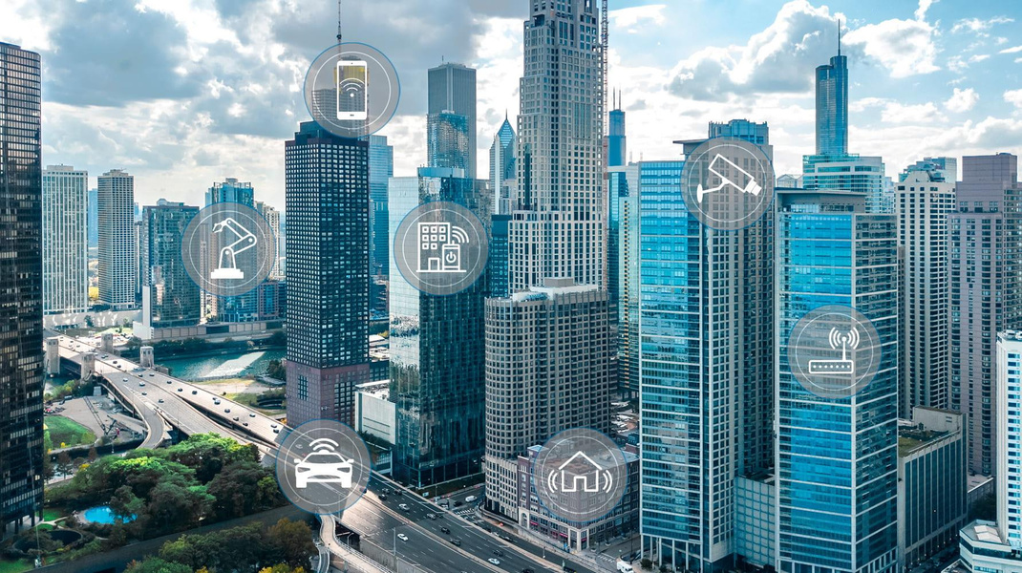
INTRODUCTION
• Rapid growth of the Internet of Things (IoT)
• Need for energy-efficient wireless communication
• Wi-Fi limitations for battery-powered devices
• ZigBee as a low-power wireless alternative
• Objective: Explore ZigBee architecture, applications & challenges
[1]

Slide 3
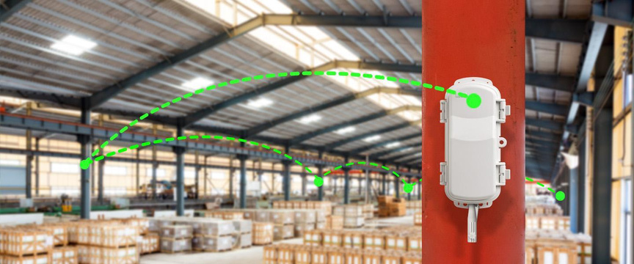
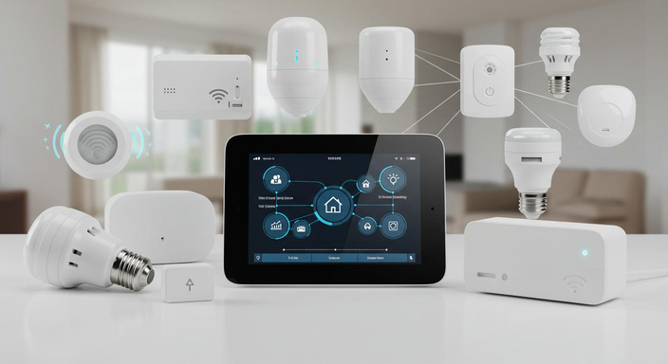
LOW-POWER WIRELESS NETWORKS
Characteristics
Applications
• Low power consumption
• Long battery life
• Low implementation cost
• Mesh networking capability
• Scalability for large deployments
• Smart homes
• Healthcare monitoring
• Environmental monitoring
• Industrial automation
• Wireless Sensor Networks (WSNs)
[2]
[3]

Slide 4
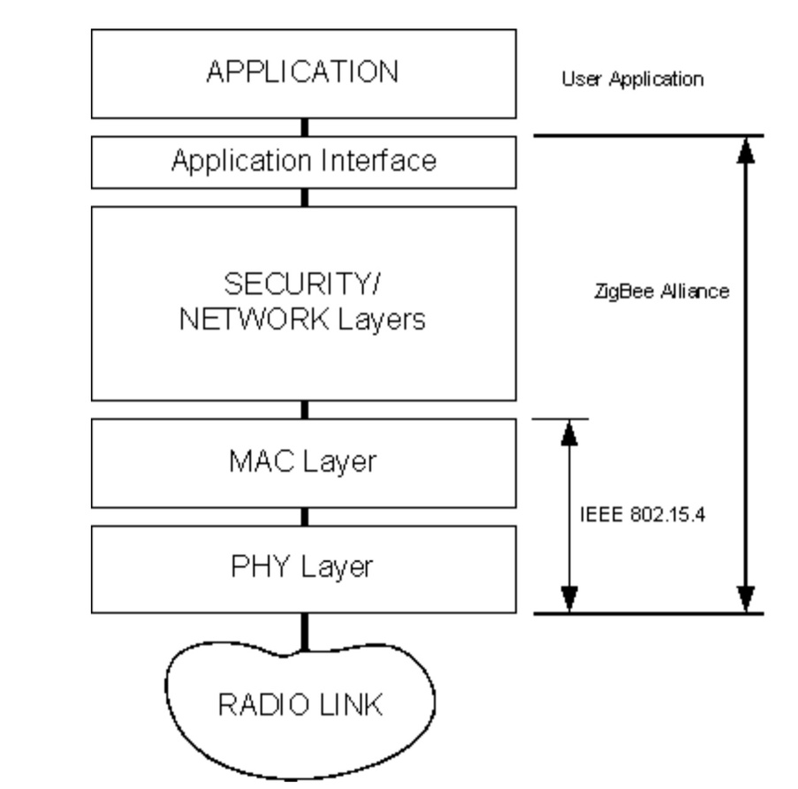
ZIGBEE ARCHITECTURE & IEEE 802.15.4
Protocol Layers:
• Based on IEEE 802.15.4 standard
• Physical (PHY) Layer
• MAC Layer
• Network (NWK) Layer
• Application (APL) Layer
Key Features:
• Mesh networking
• Routing capabilities
• Security mechanisms
• Device interoperability
Figure: ZigBee Protocol Stack
[4]

Slide 5
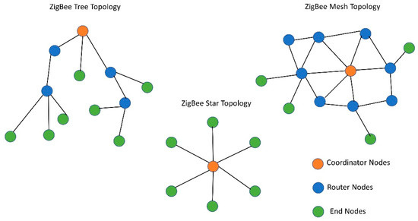
NETWORK TOPOLOGIES
Topology Types:
• Star Topology – centralized communication
• Tree Topology – hierarchical, extended range
• Mesh Topology – decentralized, multi-path
Key Highlights:
• Mesh enables self-healing networks
• Reliable, redundant communication
• Highly scalable for dense deployments
Figure: Star, Tree & Mesh Topologies

Slide 6
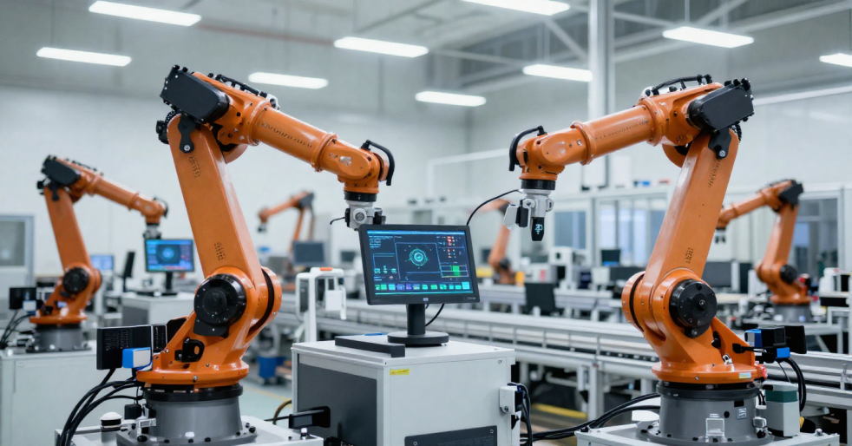
INDUSTRIAL APPLICATIONS
Smart Factory Applications:
• Temperature Monitoring – prevents overheating
• Humidity Monitoring – protects sensitive equipment
• Real-Time Monitoring – live sensor data
Key Benefits:
• Predictive maintenance
• Lower maintenance costs
• Improved machine safety
Figure: ZigBee-enabled Smart Factory Monitoring

Slide 7


SECURITY
Security Features
Challenges & Solutions
• AES-128 Encryption for data confidentiality
• Authentication protocols to verify devices
• Data integrity checks to prevent tampering
• Trust Center managing and distributing security keys
• Network-layer and application-layer security
Challenges:
• Vulnerability to replay attacks
• Risk of eavesdropping
• Susceptibility to DoS attacks
Solutions:
• Regular firmware updates
• Robust key management procedures
• Strict access control mechanisms

Slide 8
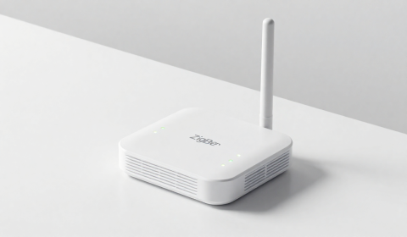
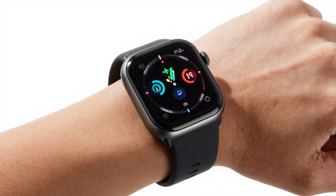
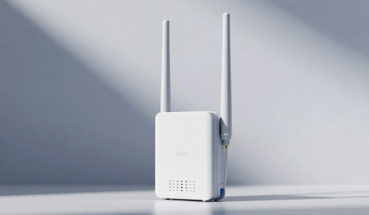
COMPARISON: ZigBee vs BLE vs LoRaWAN
ZigBee
Bluetooth Low Energy (BLE)
LoRaWAN
• Medium Range
• Low Power
• Mesh Networking
• Industrial IoT
• Long Battery Life
• Short Range
• Very Low Power
• High Data Rate
• Smartphone Compatible
• Wearable Devices
• Long Range
• Very Low Power
• Low Data Rate
• Smart Agriculture
• Smart Cities

Slide 9
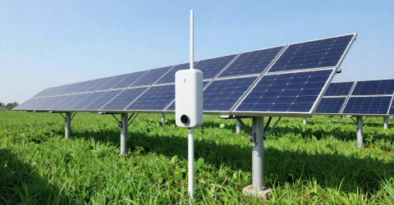
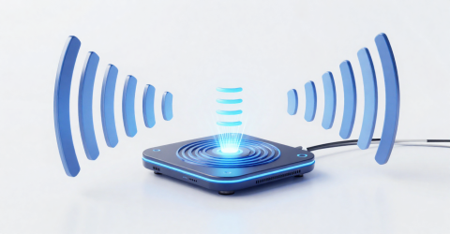

ENERGY HARVESTING
Solar Energy
RF Energy Harvesting
Mechanical Vibration
• Uses photovoltaic panels
• Powers outdoor ZigBee sensors
• Reduces battery replacement
• Harvests ambient RF signals
• Supports ultra-low-power sensors
• Supplementary energy source
• Converts vibration into electricity
• Suitable for industrial monitoring
• Enables maintenance-free operation
Key Benefits
Longer Battery Life
Reduced Maintenance
Self-Powered IoT

Slide 10
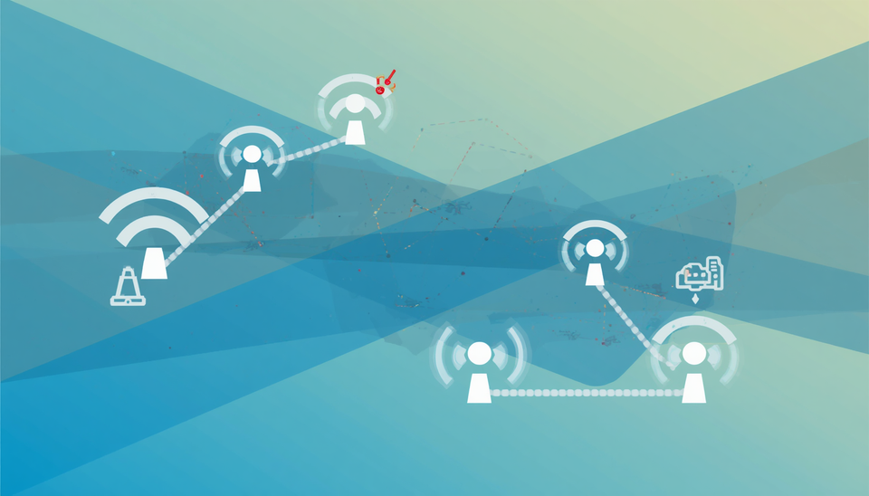
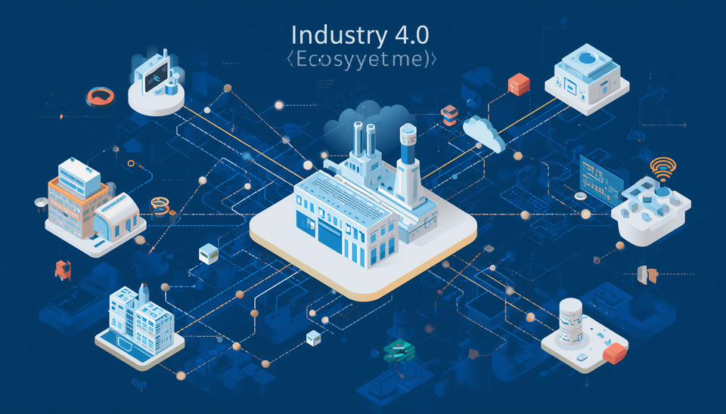
CHALLENGES & FUTURE TRENDS
Challenges
Future Trends
• Interference from other wireless systems (Wi-Fi, Bluetooth)
• Scalability limitations in ultra-large deployments
• Energy consumption of routers in mesh networks
• Limited data rate compared to modern standards
• Security vulnerabilities in dense IoT environments
• Integration with Industry 4.0 initiatives
• Edge computing for local data processing
• Cloud integration for analytics and management
• Adoption of the Matter standard for interoperability
• Development of smart infrastructure ecosystems

Slide 11
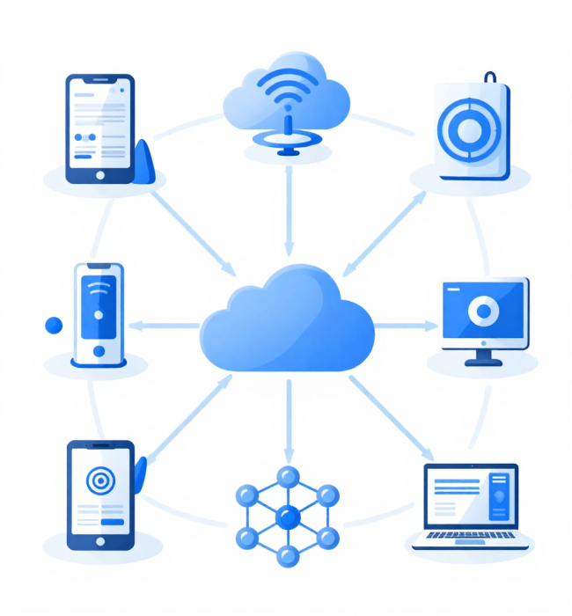
CONCLUSION
Main Findings
Low-power and energy-efficient communication
Reliable mesh networking
Secure communication using AES-128
Suitable for Industrial IoT and Wireless Sensor Networks
Future-ready with energy harvesting and smart infrastructure

Slide 12
REFERENCES
Image References
[1] Adobe Stock, "Smart City with Internet of Things (IoT)," Accessed: Jun. 30, 2026. [Online]. Available: https://stock.adobe.com
[2] Milesight IoT, "Industrial Wireless Sensor Network," Accessed: Jun. 30, 2026. [Online]. Available: https://www.milesight-iot.com
[3] Silicon Labs, "Smart Home IoT Devices," Accessed: Jun. 30, 2026. [Online]. Available: https://www.silabs.com
[4] NXP Semiconductors, "IEEE 802.15.4 / ZigBee Application Note AN3403," Rev. 1.0, 2007.
Academic References
[5] I. F. Akyildiz, W. Su, Y. Sankarasubramaniam, and E. Cayirci, "Wireless Sensor Networks: A Survey," Computer Networks, vol. 38, no. 4, pp. 393-422, 2002.
[6] K. Sohraby, D. Minoli, and T. Znati, Wireless Sensor Networks: Technology, Protocols, and Applications. Hoboken, NJ, USA: John Wiley & Sons, 2007.
[7] G. Anastasi, M. Conti, M. Di Francesco, and A. Passarella, "Energy Conservation in Wireless Sensor Networks: A Survey," Ad Hoc Networks, vol. 7, no. 3, pp. 537-568, 2009.

Slide 13
THANK YOU
Any Questions?
Md. Sayeed Anwar Seam, Mir Sharjil Hasan, Saracini Kleivi

